Slide 1
OpenPAI: The Open Source Initiative for AI Platform in China
CQU CS1701
NLP Research Group

Slide 2
Background and Motivation
Artificial Intelligence (AI) becomes one major focus and heated across academia and industries
Major opportunity to democratize AI through innovations on AI infrastructure
Lower the entry bar for new comers
Facilitate AI education
Speed up AI research
Accelerate the penetration of AI across industries

Slide 3
Current Status and Challenges of AI Platform
Still in early stage: ad hoc ways to build/deploy an AI platform
It is easy to build small-scale platforms with a narrowed, specific purpose
Need an AI platform that works in different environment and application scenario
On-premise, cloud, and hybrid environment
Image/video, speech, language, vertical domain
High compatibility, extensibility, manageability, efficiency

Slide 4
The Importance of an AI Platform
Infrastructure support for the advance of artificial intelligence
Deep learning algorithms and frameworks run on
Manage hardware
A platform to boost AI innovation and productivity
Allow researchers/practitioners to focus on AI innovation, instead of the hassles of infra. construction, deployment, management, and optimization
Enable results sharing, build a community for mutual learning/leveraging, and rapid innovation

Slide 5
An Open Platform for AI R&D and Education
The co-development of AI innovation, AI education, and AI platform evolution
Research, education, and production
Design AI course project, perform training to grow AI talent pool
Open source, result sharing, a community for collaborative innovation

Slide 6





















Overview
Cognitive Ability
Visual Perception NLU
Speech Recognition
Tools
AI Lifecycle Management Management Integration Compiling Optimization
Shared Resources
Practice Curriculum Data
Management and Intelligent Platform
Heterogeneous Cluster System-level Intelligent
Deep Learning and Intelligent Exploration
Management & Scheduling
Optimization
Infrastructure
CNTK
CPUs
Intelligent Mobile Device
Heterogeneous distributed clusters
Edge

Slide 7






China Open AI Platform Alliance

Slide 8
Open Platform for AI (OpenPAI)
A platform for GPU cluster management
Openness: open source (MIT), open collaboration model
Extensibility: support all deep learning frameworks, GPU/FPGA/ASIC
Modularity: micro-service, different component choice (storage, scheduler)
Efficiency: fine-grained GPU scheduling, support IB/RDMA
Manageability：job and platform monitoring, deployment, upgrade, etc.
Robust: fault tolerance
Practicability: leverage the mature design and practice in Microsoft

Slide 9
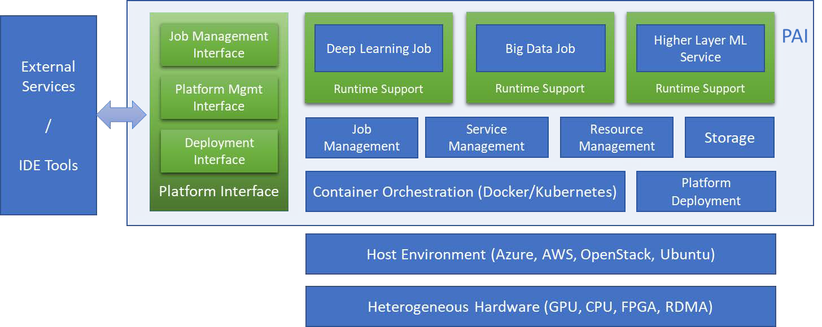
OpenPAI Architecture

Slide 10











Implementation
Web Portal
Deep Learning Jobs
Big Data Jobs
AutoML Jobs
Visual Studio Tools for AI
REST Server
PAI Runtime
PAI Runtime
PAI Runtime
Launcher Server
Hadoop+AI
HDFS
ZooKeeper
Managed by k8s
Kubernetes Cluster Management
Managed by Hadoop+AI
Docker / Ubuntu
https://github.com/Microsoft/pai

Slide 11
OpenPAI – Modularized (containerized) AI Platform
PAI marketplace
AI asset sharing
PAI protocol – resource specification
Data, code, docker image
Hardware requirement
Job Launcher
Understand PAI protocol and execute the job accordingly
Onboard new AI workload w/o modifications to the platform
Deployment in different environment
Single-box, cloud, on-prem, hybrid

Slide 12






An Open Ecosystem: Engage with China AI Community

Slide 13
Train models on OpenPAI
CQU CS1701
NLP Research Group

Slide 14
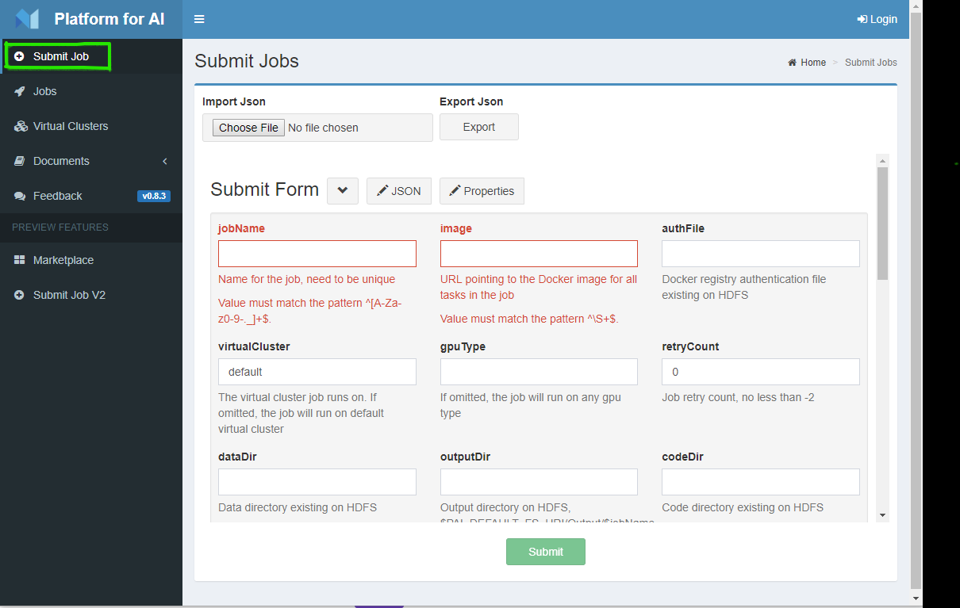

Slide 15
{
"jobName": "tensorflow-cifar10",
"image": "tensorflow/tensorflow:1.12.0-gpu-py3",
"taskRoles": [
{
"name": "default",
"taskNumber": 1,
"cpuNumber": 4,
"memoryMB": 8192,
"gpuNumber": 1,
"command": "apt update && apt install -y git && git clone https://github.com/tensorflow/models && cd models/research/slim && python download_and_convert_data.py --dataset_name=cifar10 --dataset_dir=/tmp/data && python train_image_classifier.py --dataset_name=cifar10 --dataset_dir=/tmp/data --max_number_of_steps=1000"
}
]
}

Slide 16
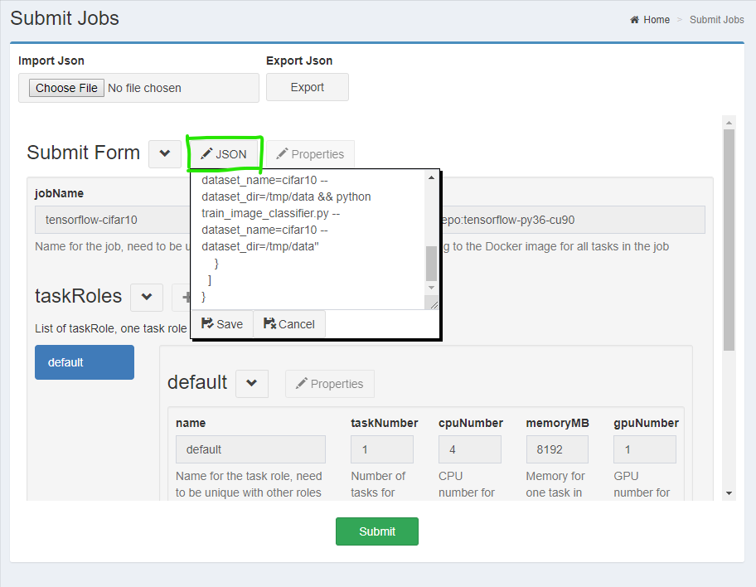

Slide 17
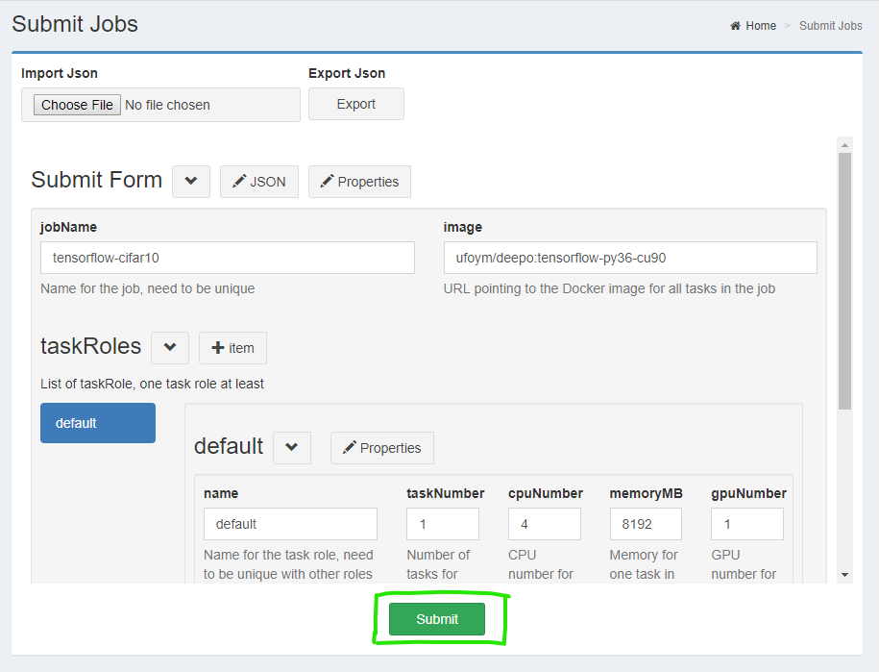

Slide 18
Build a Docker Image
CQU CS1701
NLP Research Group

Slide 19
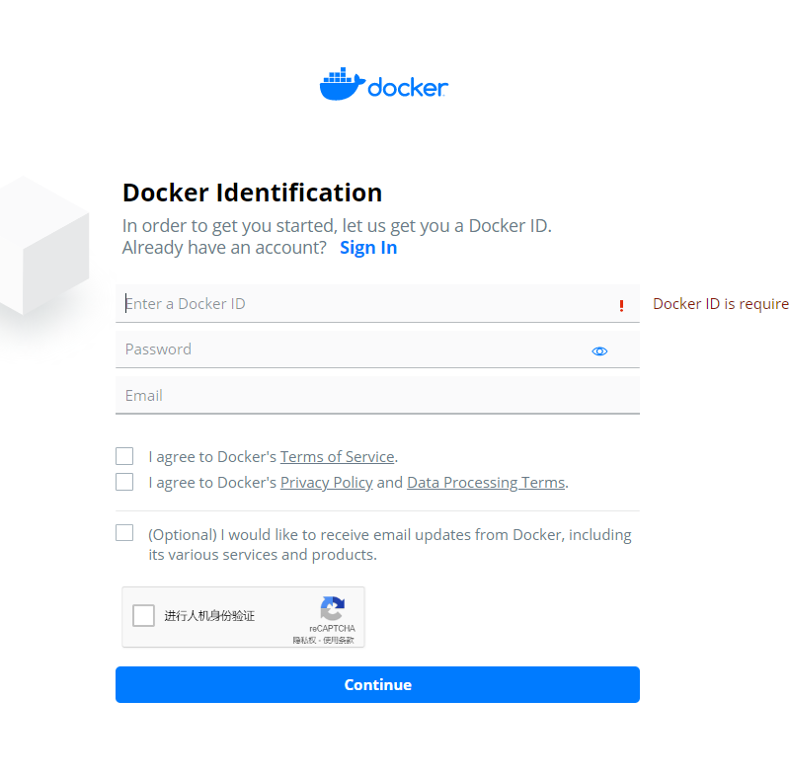
Regist a docker-hub account
Regist url: https://hub.docker.com/signup
Sign in url: https://hub.docker.com/signup

Slide 20
Install Docker-CE(Ubuntu)
Step0: Install the Windows Subsystem for Linux(If use windows10)
Step1: Uninstall old versions
Step2: Install Docker Engine – Community
Install using the repository
Install from a package

Slide 21
Install the Windows Subsystem for Linux
Open PowerShell as Administrator and run:
Enable-WindowsOptionalFeature -Online -FeatureName Microsoft-Windows-Subsystem-Linux
Restart your computer when prompted.
Download Ubuntu and install from the Microsoft
Run Ubuntu Subsystem

Slide 22
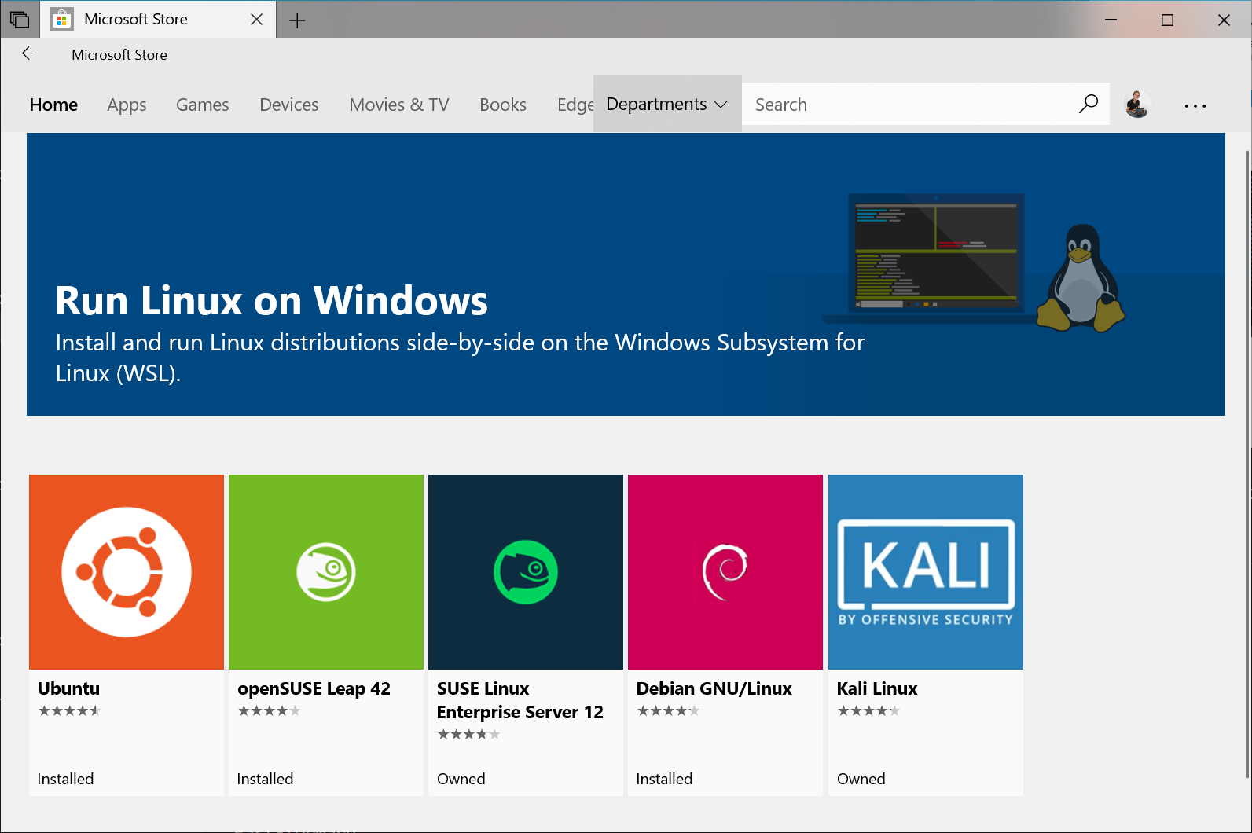

Slide 23
Install from a package
Go to https://download.docker.com/linux/ubuntu/dists/, choose your Ubuntu version, browse to pool/stable/, choose amd64 and download the .deb file for the Docker Engine - Community version you want to install.
Install Docker Engine - Community, changing the path below to the path where you downloaded the Docker package.
sudo dpkg -i /path/to/package.deb
Verify that Docker Engine - Community is installed correctly by running the hello-world image.
sudo docker run hello-world

Slide 24
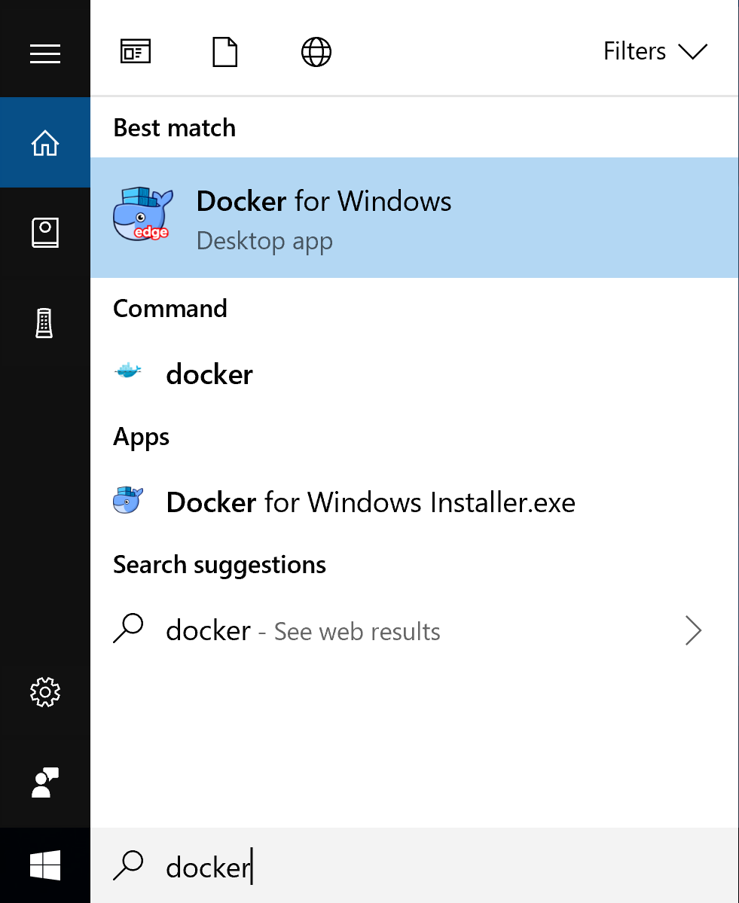
Install Docker Desktop(Windows)
Download Docker Desktop(CE version)
https://hub.docker.com/editions/community/docker-ce-desktop-windows
Install Docker Desktop for Windows desktop app
Start Docker Desktop for Windows
Run Docker
Input command in Powershell

Slide 25
Build your own docker environment
Download base Dockerfile
Build Docker image
cd ../Dockerfiles/cuda8.0-cudnn6
sudo docker build -f Dockerfile.build.base -t pai.example.jupyter .
Push the Docker image to Docker-Hub
sudo docker tag pai.example.jupyter USER/pai.example.jupyter
sudo docker push USER/pai.example.jupyter

Slide 26
Use your own Docker image to submit jobs
{
"jobName": "test_store",
"image": "lvyufengh/pai.example.jupyter",
"virtualCluster": "default",
"taskRoles": [
{
"name": "test_store",
"taskNumber": 1,
"cpuNumber": 4,
"memoryMB": 32000,
"gpuNumber": 1,
"command": "sleep infinity"
}
]
}

Slide 27
Some commands
apt install nfs-common && mkdir /models && mount -t nfs4 <server address>:<server path> /models
showmount -e 202.202.5.138

Slide 28
Thank you!

